Slide 1
Point of Sale System
Trevor Huffman, Joshua Collins-McDowell, Zachary Hartman

Slide 2
Our Profile
Trevor Huffman: My qualifications to do this assignment is a background in basic Java through taking Programming 1 and 2 in Java with UCM. I think my strengths lie in an ability to use database management systems like SQL to track and upkeep the databases that hold our ingredient lists, etc. I failed Data Structures once before, so I don’t think I have many positive attributes or abilities in using data structures to create this program.
Joshua Collins-Mcdowell : I have taken several types of programming language classes such as Python, C++, Unix, SQL, and Java. I also have always been attentive to details and can problem solve to figure out what an error or bug is being caused by. My weakness would be not having any official software development experience yet and working with a team to solve a larger problem with coding. I currently work at a warehouse and use inventory management software all day.
Zachary Hartman: I have taken courses in Java, Python, SQL, Project Management and have done projects related to commercial products. While I would not consider myself a master, I am good with public speaking and presenting ideas, as well as problem solving and troubleshooting code.

Slide 3
Background:
Retail and Food-Industry stores use the Point of Sale (POS) systems, which track menu items and print tickets much like our product will. We, here, are producing a POS system that virtually eliminates physical tickets.
Main functionalities of a POS system include: The system determines the price of the item(s), payment is processed, transaction completes(the emailed receipt is the sign of this).
Components of a POS system: Software with a front and back end, and hardware. For this project, our POS hardware will be a PC monitor, and a receipt printer which we will set up to send an email to the buyer, reminding them of their purchase.
Challenges of managing a POS system: Vulnerability to cyber attacks (in the form of poor encryption, internet exposure, unsecure data storages) and the inability to have a flexible menu

Slide 4
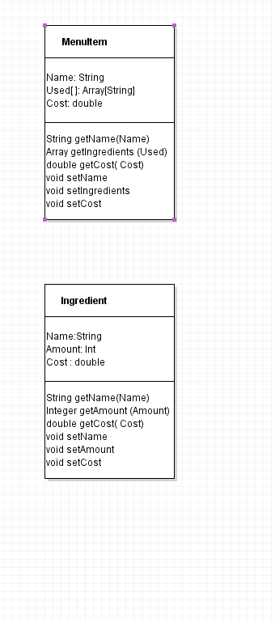
Proposed Project Description:
Build a modular application that allows users to edit and track menu items, ingredients and sold numbers. Users will be able to edit existing menu items, track basic metrics and push tickets to a Point-Of-Sale system for order handling.
We are targeting all businesses that require a system to track ingredients/consumable items that make up store products. This includes, but is not limited to: Restaurants, Custom storefronts (cars, figurines, etc) and Inventory based merchants (shirts, custom clothing).

Slide 5
What We Will Use
Java: Backend logic
SQLlite: Self contained SQL server that can ship with the project already set up
JavaFX: Graphical UI (GUI)

Slide 6
Assumptions
Assumptions:
Every fresh system starts with no objects and no consumables
If the item is a non-consumable menu item, the object will have a SKU number (Stock Keeping Unit).
Users will not be able to register unique UPC, items with UPC labels must be inputted from UPC label or not at all

Slide 7
Goals (should we have time)
Cash. Secure online payments through your eCommerce site. Magstripe credit cards, which are cards that you swipe. Chip cards, which are credit cards with an embedded chip. Contactless payments, which might include a contactless card that customers tap or a mobile wallet (e.g., Google Pay or Apple Pay). Card-not-present transaction, which happens when your customer and their credit card aren’t actually in front of you, so you have to manually enter their credit card information. This also occurs when a customer enters their payment details while checking out online.

Slide 8
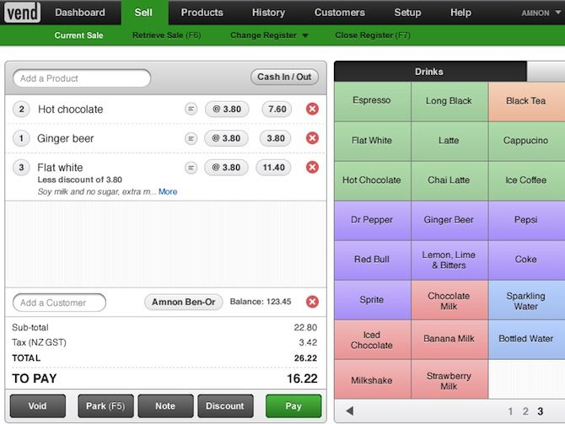
Example Mock-up

Slide 9
Current Database Tables
Ingredient Table: Tracks the amount of ingredients and how much they are costing “per unit”, which would be a sellable bundle Cost and Profit sheet: Tracks current costs and income, and calculates the loss or profit of a day, which is then aggregated to the Monthly loss and profit section Month Profit: Self explainitory, aggregate of daily profits/losses
Consumable | In-stock | Price Per Unit | Max | Min
Buns | 500 | 2.50 | 500 | 50
Burger Patty | 200 | 3.00 | 500 | 50
Cheese | 350 | 1.50 | 500 | 50
Day | Cost | Income | Profit/Loss | Month
5/1 | 500.00 | 1000.00 | 500.00 | 5
5/2 | 500.00 | 1500.00 | 1000.00 | 5
5/3 | 2500.00 | 1000.00 | -1500.00 | 5
Month | Profit/Loss
5

Slide 10
Questions?

